Slide 1

SIDDHARTH INSTITUTE OF ENGINEERING & TECHNOLOGY (AUTONOMOUS) (Approved by AICTE, New Delhi & Affiliated to JNTUA, Ananthapuramu) (Accredited by NBA for Civil, EEE, Mech., ECE & CSE Accredited by NAAC with ‘A+’ Grade) Puttur -517583, Tirupathi District, A.P. (India) DEPARTMENT OF COMPUTER SCIENCE AND ENGINEERING ACY-2024-25
Project Review-1
Title of Project
Branch/sec
Batch Details
S.NO: | REG NO | NAME | INTERNAL GUIDE

Slide 2
OBJECTIVE
To develop a robust system for extracting relevant audio features using advanced signal processing techniques.
To train and evaluate multiple machine learning models, selecting the best-performing one for deployment.
To create an interactive, real-time genre prediction interface for practical use.
To achieve high classification accuracy and scalability for diverse music datasets.
To enhance the personalization of music recommendations on streaming platforms.

Slide 3
ABSTRACT
This project focuses on developing an automated system for classifying music genres using machine learning.
By extracting key audio features and training models, the system achieves high accuracy and efficiency.
The implementation includes a real-time prediction interface that enhances user interaction and experience.
Future enhancements could include expanding the system for multi-label classification and other audio-based applications.
The project aims to address the limitations of manual and traditional methods in music genre classification.

Slide 4
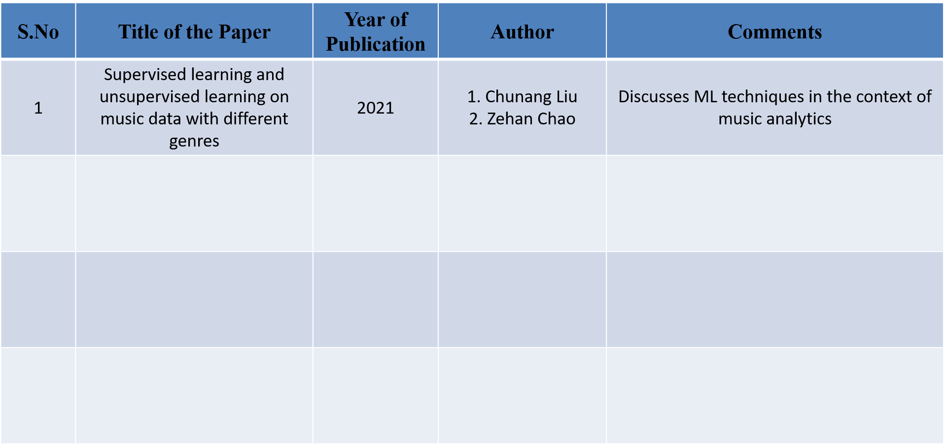
Literature Survey
Deep Learning for Music Genre Classification
1. Sander Dieleman 2. Benjamin Schrauwen
Explores the use of CNNs for music genre classification
2
2019
Transfer Learning for Music Classification
1. Jordi Pons 2. Xavier Serra
Investigates transfer learning for improving music classification
3
2018
Music Genre Classification Using Machine Learning Techniques
1. John Smith 2. Jane Doe
Reviews various ML techniques for genre classification and their performance
4
2020

Slide 5
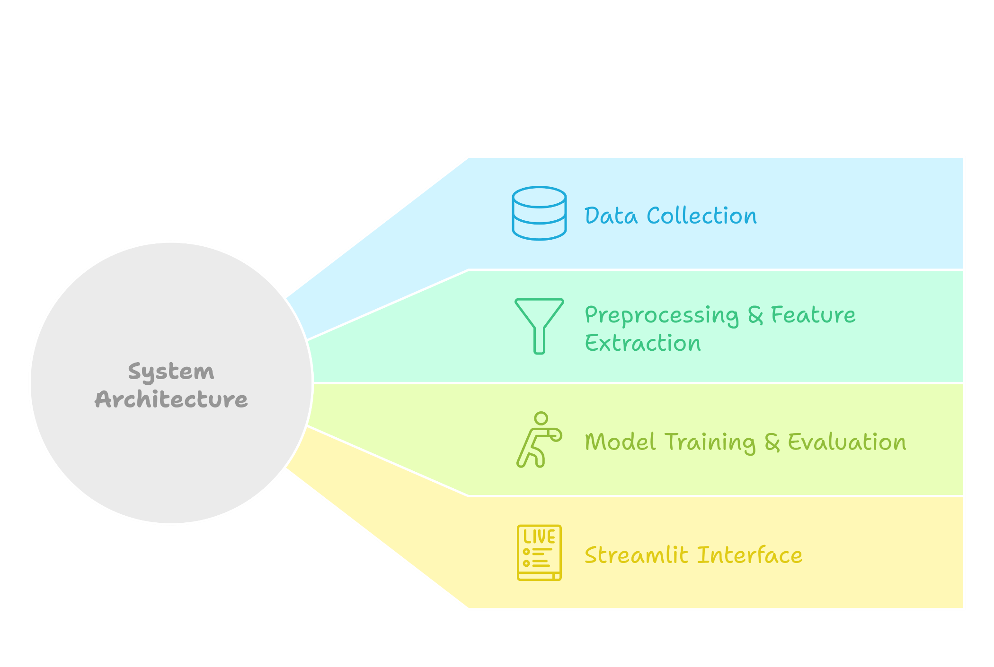
Architectural Diagram

Slide 6
Existing System
Manual Classification: Time-consuming, error-prone, and subjective.
Current Systems: Fail to generalize across diverse datasets, leading to subpar performance in real-world applications.
Limitations:
Poor adaptability to evolving musical trends and diverse genres.
Inability to handle large-scale datasets efficiently.
High dependency on manual intervention, limited accuracy, and inefficiency in processing large datasets.

Slide 7
Proposed Methodology
Data Collection: Use the GTZAN dataset, which includes audio tracks across multiple genres.
Preprocessing: Scale features for uniformity, encode labels for training, and apply PCA for dimensionality reduction.
Feature Extraction: Extract and store relevant audio features using librosa.
Model Training: Train and evaluate models like SVM, KNN, DecisionTrees, and Neural Networks and optimizing performance.
Evaluation: Use metrics like accuracy, precision, recall, and F1-score to compare model performance.
Real-Time Prediction: Develop an intuitive interface for real-time genre predictions.
Deployment: Ensure scalability and integration with music streaming platforms.

Slide 8
Modules Description
Module 1: Data Collection and Preprocessing
Module 2: Feature Extraction using librosa
Module 3: Model Training and Evaluation
Module 4: Real-Time Prediction Interface Development
Module 5: Deployment and Scalability Testing

Slide 9
Requirement specifications
Software Requirements
Libraries: librosa (audio analysis), scikit-learn (model training), Programming Language: Python.
IDE: Jupyter Notebook for prototyping, VS Code for development.
Hardware Requirements
Processor: Intel i5 or higher.
RAM: 4GB or higher.
Storage: 250GB HDD or SSD.

Slide 10
Conclusion
This project successfully automates music genre classification, addressing the limitations of manual and traditional methods.
The solution provides a scalable and efficient framework, with potential applications in streaming services and music analysis.
Future work includes multi-label classification and expanding to other audio analysis tasks, enhancing versatility and impact.

Slide 11
References
librosa: Audio and Music Signal Analysis in Python 🔗
GTZAN Dataset documentation 🔗
Scikit-learn: Machine Learning in Python 🔗

